Slide 1
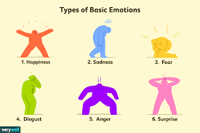
Emotion detection for the Work From Home tweets
Project By
Arjun Chowhan
Niteesha Balla
Naman Shah

Slide 2
Contents
Introduction
Collecting WFH Tweets
Text Preprocessing
Sentiment Analysis
Emotion detection

Slide 3

Introduction
In the past, remote employees have had a bad reputation. Many employers believed their workforce would be too easily distracted at home, where their managers couldn’t keep an eye on their direct reports.
Today, remote work has made its place in society due to its mandatory need during the pandemic and has proven efficient enough to be kept ongoing as the new normal in some organizations even after the reduced effects of the virus outbreak.
We were fascinated to dig into the discussion related to work from home (#WFH) on Twitter, and so decided to explore what emotion the tweets express, to get a notion about the feelings of people regarding this culture and to gain an insight about the possible continuity of this trend.

Slide 4
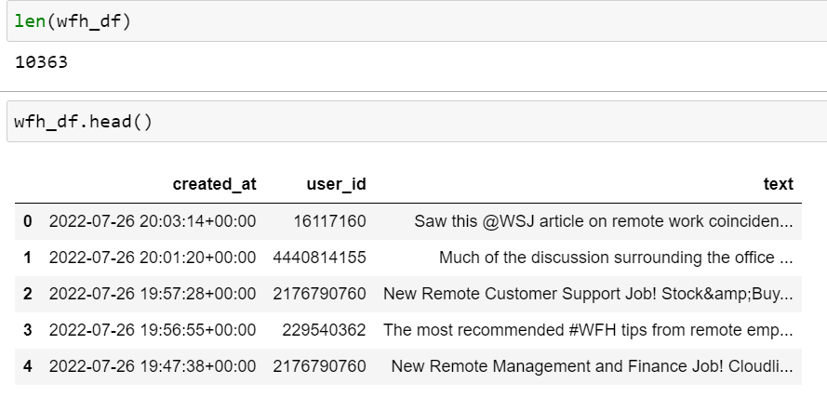
Collecting WFH Tweets
To collect the tweets, we used the keys and tokens of our twitter developer account.
We have collected the tweets with the hashtag #WFH and #WorkFromHome.
We have collected around 10k tweets.
We have tweets for 1 week.

Slide 5
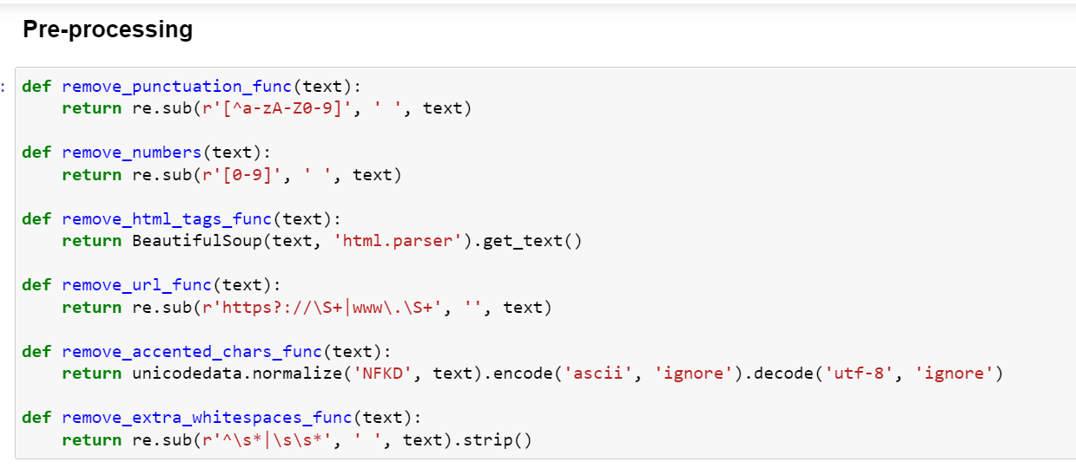
Text Preprocessing
We have to remove:
Punctuations
Numbers
HTML tags
URLs
Accented characters
Extra white spaces

Slide 6
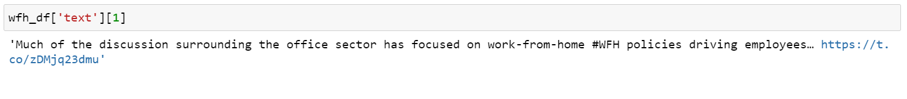
Tweets before and after pre-processing

Slide 7
Sentiment Analysis
VADER (Valence Aware Dictionary for sEntiment Reasoning) is a model used for text sentiment analysis that is sensitive to both polarity (positive/negative) and intensity (strength) of emotion.
It is a lexical approach for analyzing sentiments.
Lexical approaches aim to map words to sentiment by building a lexicon or a ‘dictionary of sentiment.’ The sentiment score of a text can be obtained by summing up the intensity of each word in the text.

Slide 8
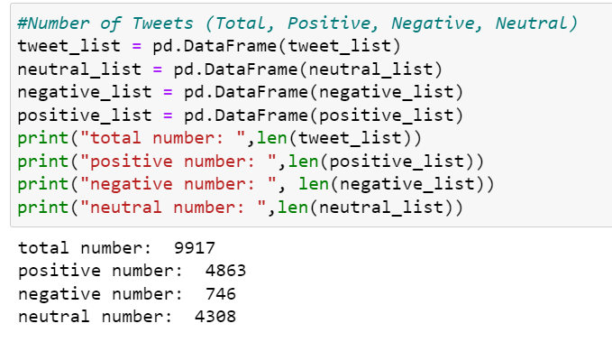
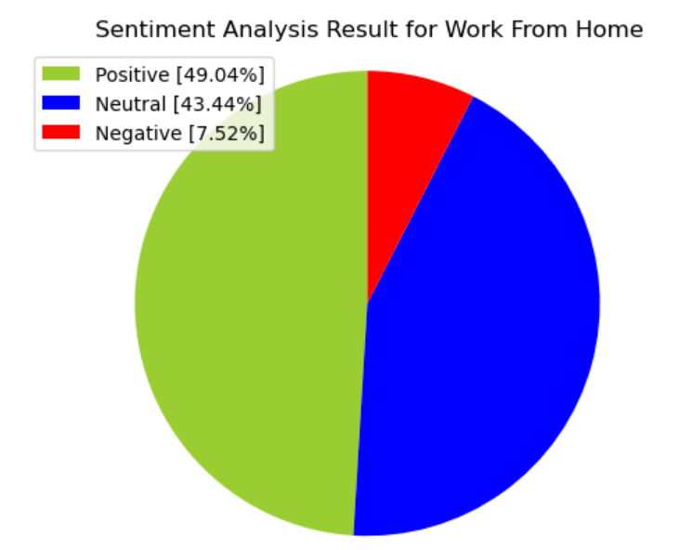
Sentiment Analysis results

Slide 9
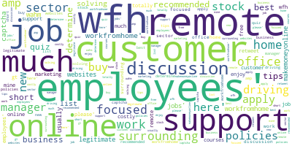
Word cloud for positive tweets
These are the most common words that appeared in the positive tweets.
Such as focused, driving, best, recommended, much etc.

Slide 10
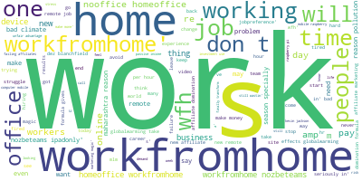
Word cloud for negative tweets
These are the most common words appeared in the negative tweets.
Such as don’t, problem, failure, struggle, hard etc.

Slide 11
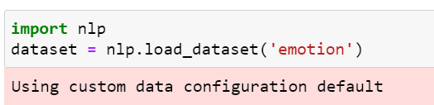
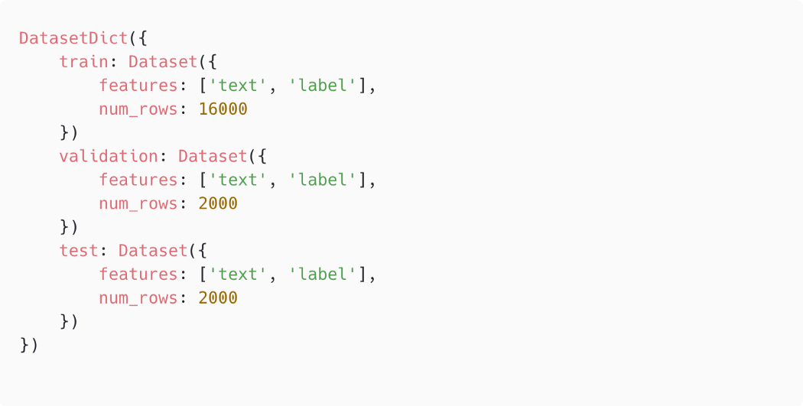
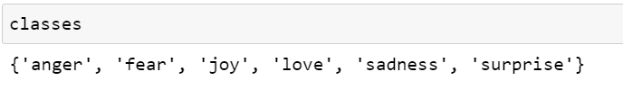
Emotion detection
We have used a pre-built dataset to train the model which can be accessed from the nlp library.
This dataset contains 6 different emotions.

Slide 12
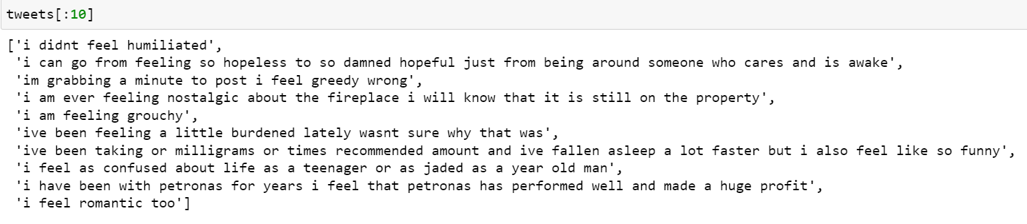
Dataset

Slide 13
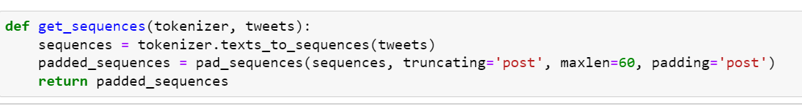
Dataset Pre-processing
Tokenization: Tokenization breaks the raw text into words, sentences called tokens. These tokens help in understanding the context or developing the model for the NLP. The text is tokenized into words by taking maximum words as 10000.
Padding: The length of the text is set as 60 and the remaining words are either truncated or padded with zeros if the length of the text is less than 60.

Slide 14
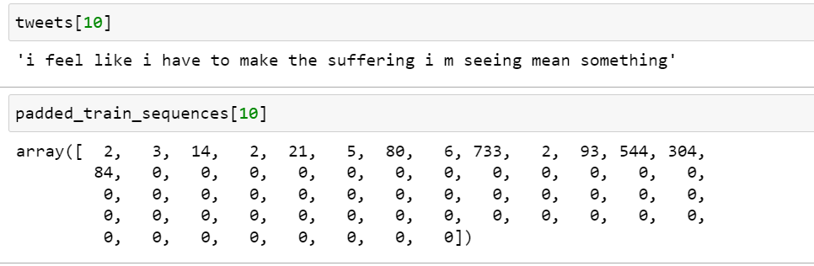
Text before and after pre-processing

Slide 15
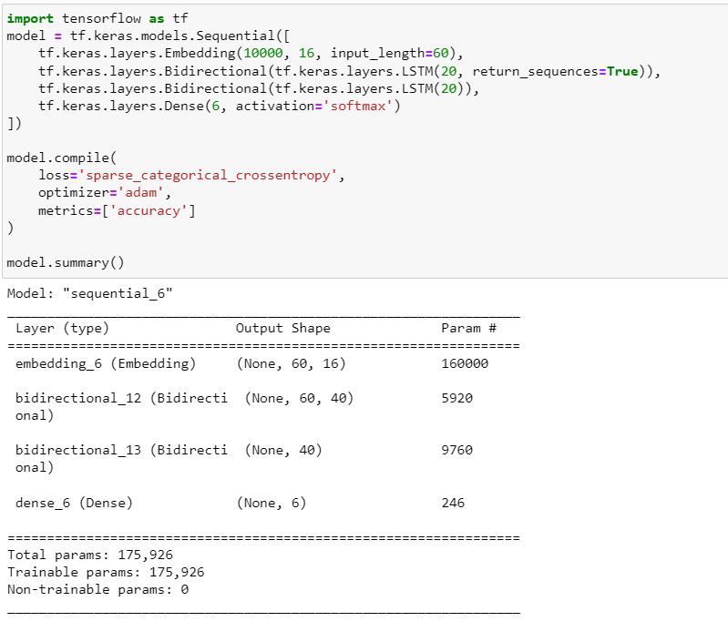
Model architecture
There are 3 different layers in our model.
Embedding layer.
LSTM: We used Bidirectional LSTM to predict the emotions.
Dense layer.

Slide 16
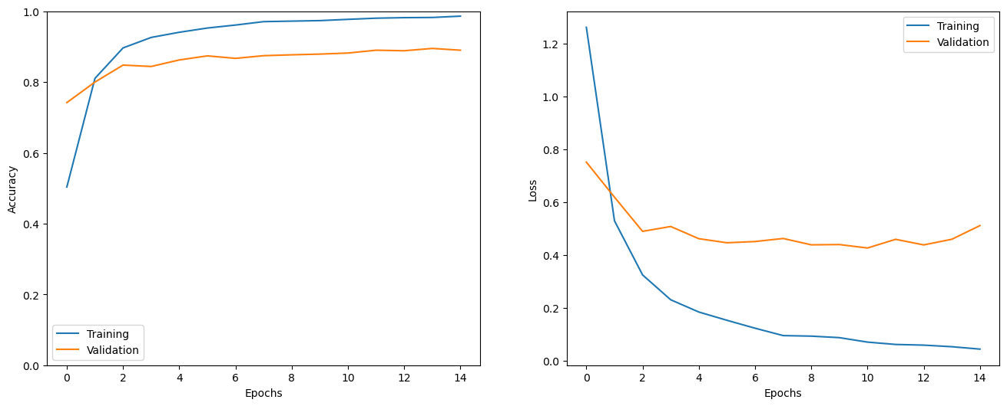
Training: 15 epochs, accuracy: 98%, testing accuracy: 88%

Slide 17
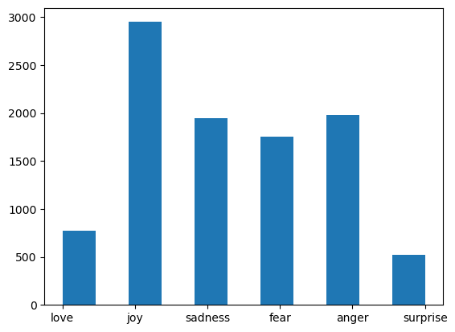
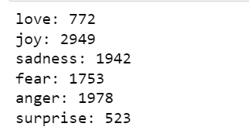
Model performance on WFH tweets
Most of the tweets are classified as joy that means most of the employees enjoyed work from home.

Slide 18
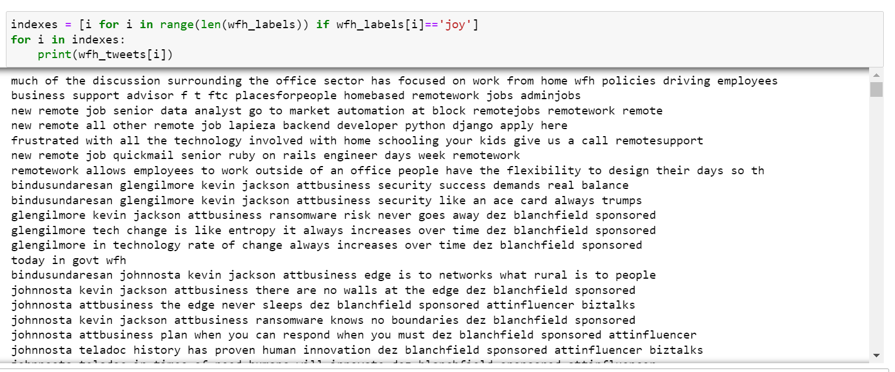
Joy tweets

Slide 19
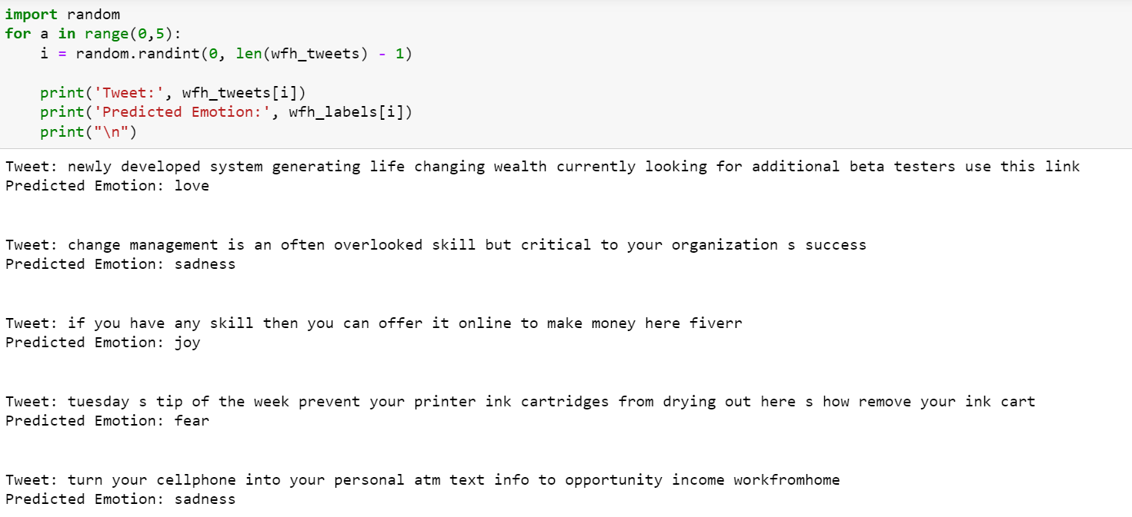
Some random tweets with their emotions

Slide 20

Thank You

